Slide 1
MICRO CREDIT DEFAULTER
By : YATIKA TANEJA

Slide 2
Objective of the study
The objective of our project is to build a model which can be used to predict in terms of a probability for each loan transaction, whether the customer will be paying back the loaned amount within 5 days of insurance of loan. In order to improve the selection of customers for the credit, the client wants some predictions that could help them in further investment and improvement in selection ofcustomers.
In this case, Label ‘1’ indicates that the loan has been payed i.e. Non- defaulter, while, Label ‘0’ indicates that the loan has not been payed i.e. defaulter.

Slide 3
BUSINESS MODEL
We are working with one such client that is in Telecom Industry. They are a operator model, offering better products at Lower Prices to all value conscious customers through a strategy of disruptive innovation that focuses on the subscriber.
They understand the importance of communication and how it affects a person’s life, thus, focusing on providing their services and products to low
income families and poor customers that can help them in the need of hour.
They are collaborating with an MFI to provide micro-credit on mobile balances to be paid back in 5 days. The Consumer is believed to be defaulter if he deviates from the path of paying back the loaned amount within the time duration of 5 days. For the loan amount of 5 (in Indonesian Rupiah), payback amount should be 6 (in Indonesian Rupiah), while, for the loan amount of 10 (in Indonesian Rupiah), the payback amount should be 12 (in Indonesian Rupiah).

Slide 4
DATA SOURCES
The sample data is provided to us from our client database. The dataset has 209593 observations and 36 features. In this case, Label ‘1’ indicates that the loan has been payed i.e. Non- defaulter, while, Label ‘0’ indicates that the loan has not been payed i.e. defaulter.
The dataset is imbalanced. Label ‘1’ has approximately 87.5% records, while, label ‘0’ has approximately 12.5% records.

Slide 5
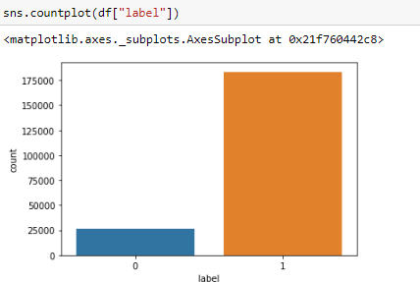
IMBALANCED DATA

Slide 6
DATA PREPROCESSING
It consists into approximately 209593 observations and 37 features granted by the company. The dataset is quite clean and the figures can be considered as ground truth, but lots of columns are either irrelevant, very sparse or non informative
Excluding features for which the information is incomplete, or uninformative, we get a total of 19 features.
There are no missing values in the dataset and date feature is converted from object to date data type.

Slide 7
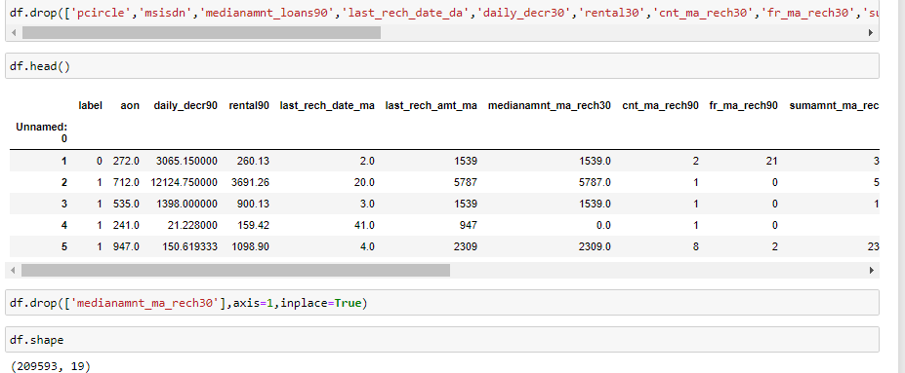
Data preprocessing

Slide 8
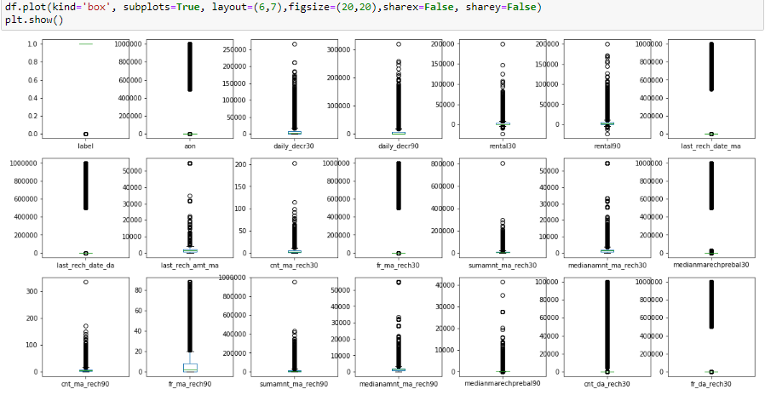
DATA VISUALIZATION
(a) Box Plots
It gives much clearer idea of distribution of features and detect if outliers are present or not

Slide 9
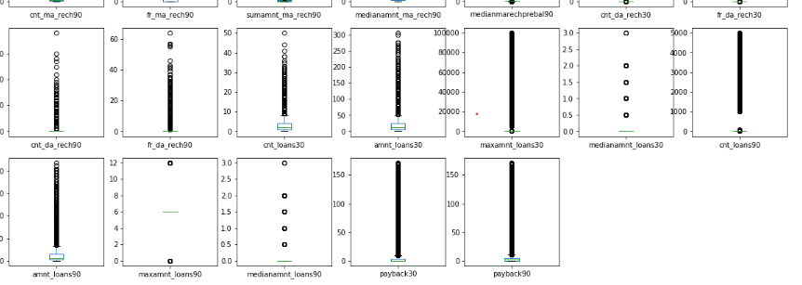
BOX PLOTS

Slide 10
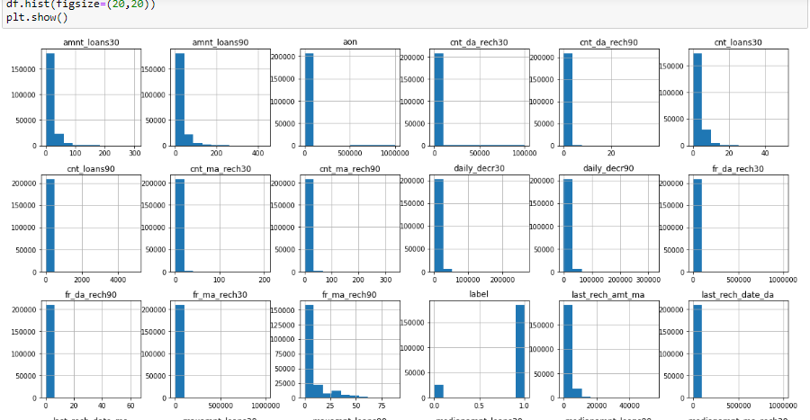
DATA VISUALIZATION
(B) HISTOGRAM

Slide 11
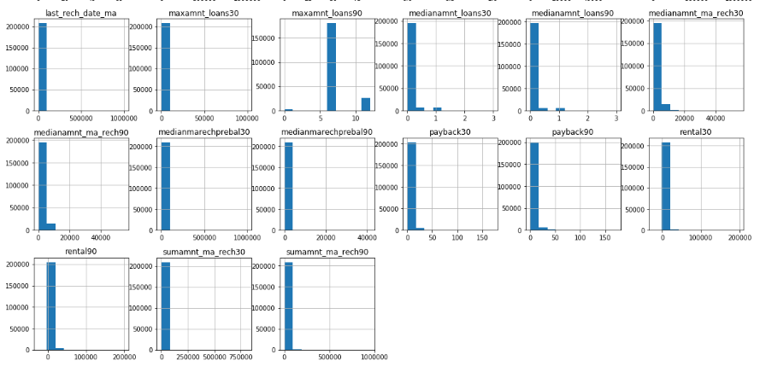
HISTOGRAM

Slide 12
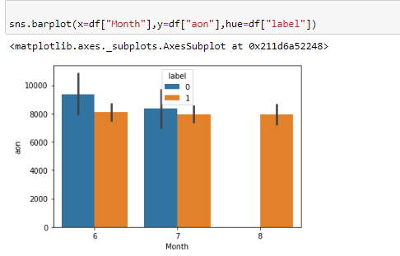
BARPLOT
a. Relationship between month , aon and label

Slide 13
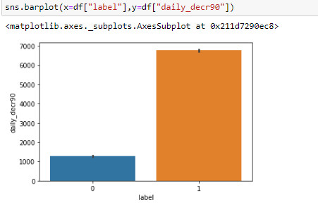
BARPLOT
b. Relationship between label and daily_decr90

Slide 14
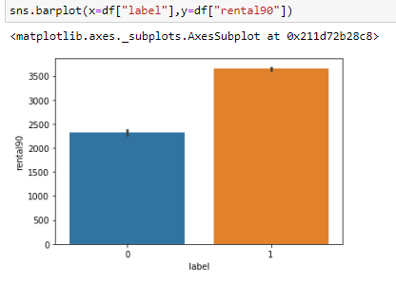
BARPLOT
c. Relationship between label and rental90

Slide 15
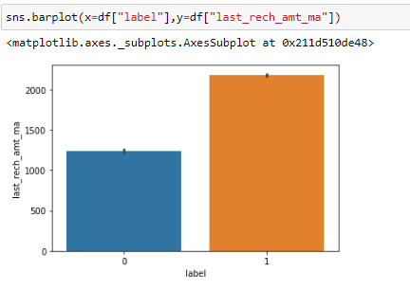
BARPLOT
d. Relationship between label and last_rech_amt_ma

Slide 16
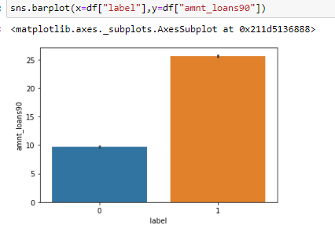
BARPLOT
e. Relationship between label and amnt_loans90

Slide 17
MODELS APPLIED
Logistic Regression:
Linear Discriminant Analysis:
K-nearest Neighbors:
Decision Tree Classifier:
Gaussian Naïve Bayes:

Slide 18
MODEL EVALUATION
We will use stratified 10-fold cross validation to estimate model accuracy.
EVALUATION METRIC: ACCURACY
This is a ratio of the number of correctly predicted instances divided by the total number of instances in the dataset multiplied by 100 to give a percentage (e.g. 95% accurate). We will be using the scoring variable when we run build and evaluate each model next.

Slide 19
ACCURACY RESULT
LOGISTIC REGRESSION : 0.874524 (0.000393)
LINEAR DISCRIMINANT ANALYSIS: 0.874709 (0.000182)
K-NEAREST NEIGHBORS: : 0.882063 (0.001791)
DECISION TREE CLASSIFIER: : 0.884091 (0.002200
GAUSSIAN NAIVE BAYES: : 0.575128 (0.006369)

Slide 20
SELECT BEST METHOD
Decision Tree Classifier has the largest estimated accuracy score at about 0.884 or 88.4%
We can also create a plot of the model evaluation results and compare the spread and the mean accuracy of each model. There is a population of accuracy measures for each algorithm because each algorithm was evaluated 10 times (via 10 fold-cross validation)

Slide 21
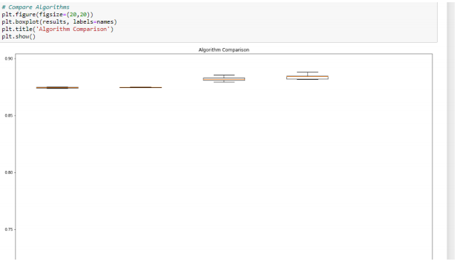
COMPAIRING MODELS

Slide 22
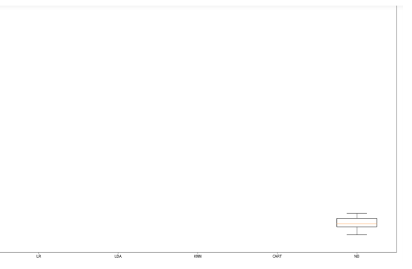
COMPARING MODELS

Slide 23
RESULT
The cross validation score suggests that Decision Tree Classifier is the best model
The accuracy is 0.886 or about 88.6% on the hold out dataset.
The confusion matrix provides an indication of the errors made.
Finally, the classification report provides a breakdown of each class by precision, recall, f1-score and support showing excellent results

